Slide 1


MANY WAYS TO USE IATI DATA
27 april 2015, Pelle Aardema
Image © Keith Williamson, used under CC-BY-2.0, https://flic.kr/p/9cZ7ya

Slide 2
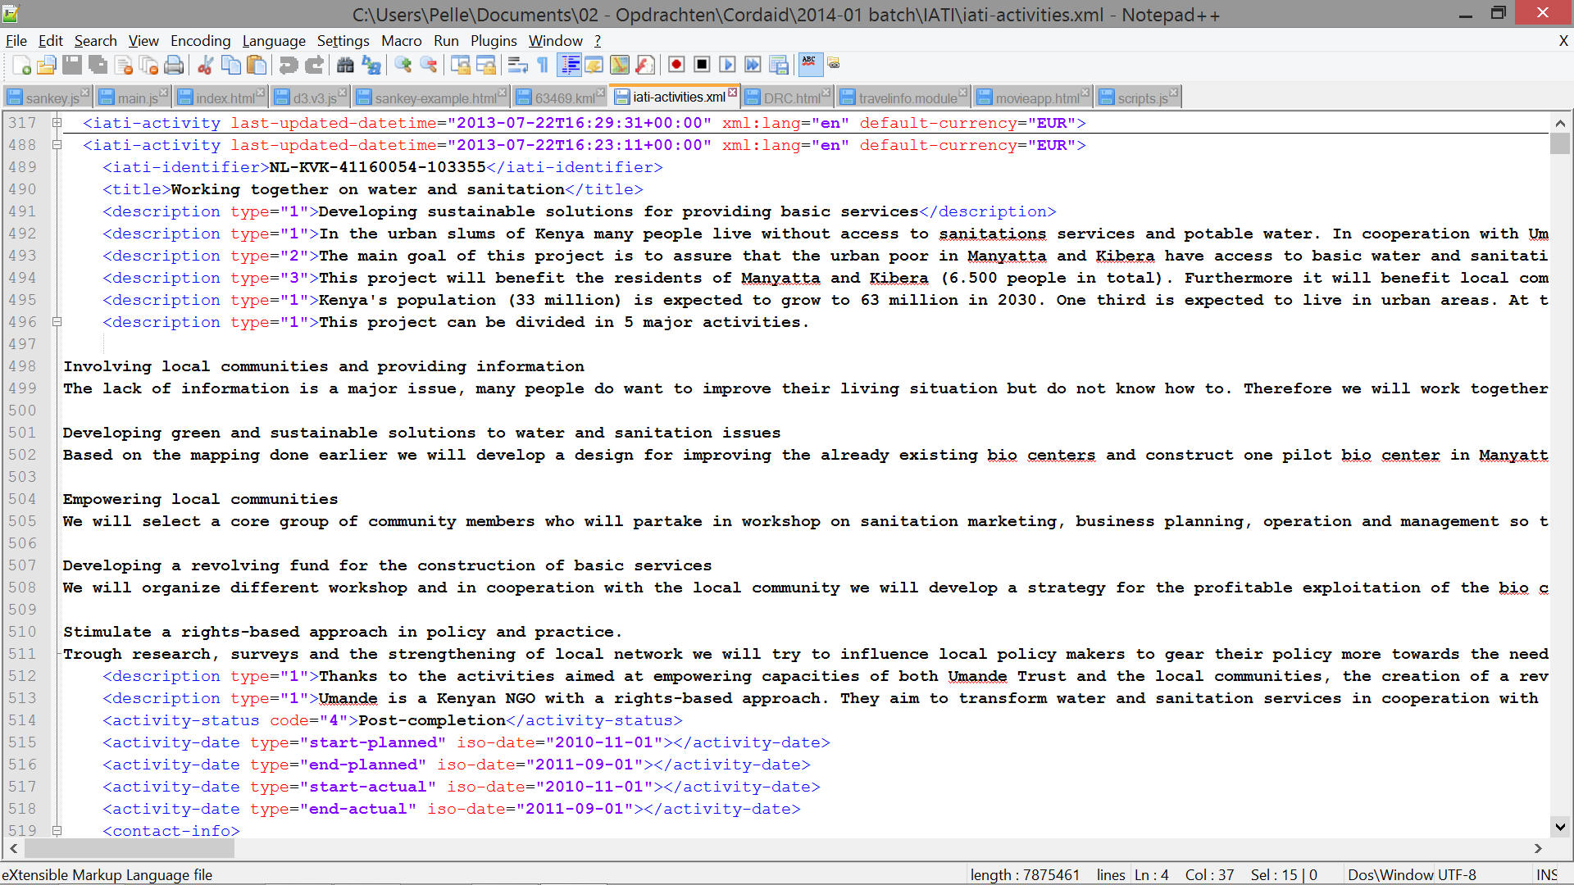
BY ITSELF, IATI DATA IS NOT SO PRETTY TO LOOK AT, SO HOW CAN YOU MAKE IT PRETTY & MEANINGFUL?

Slide 3
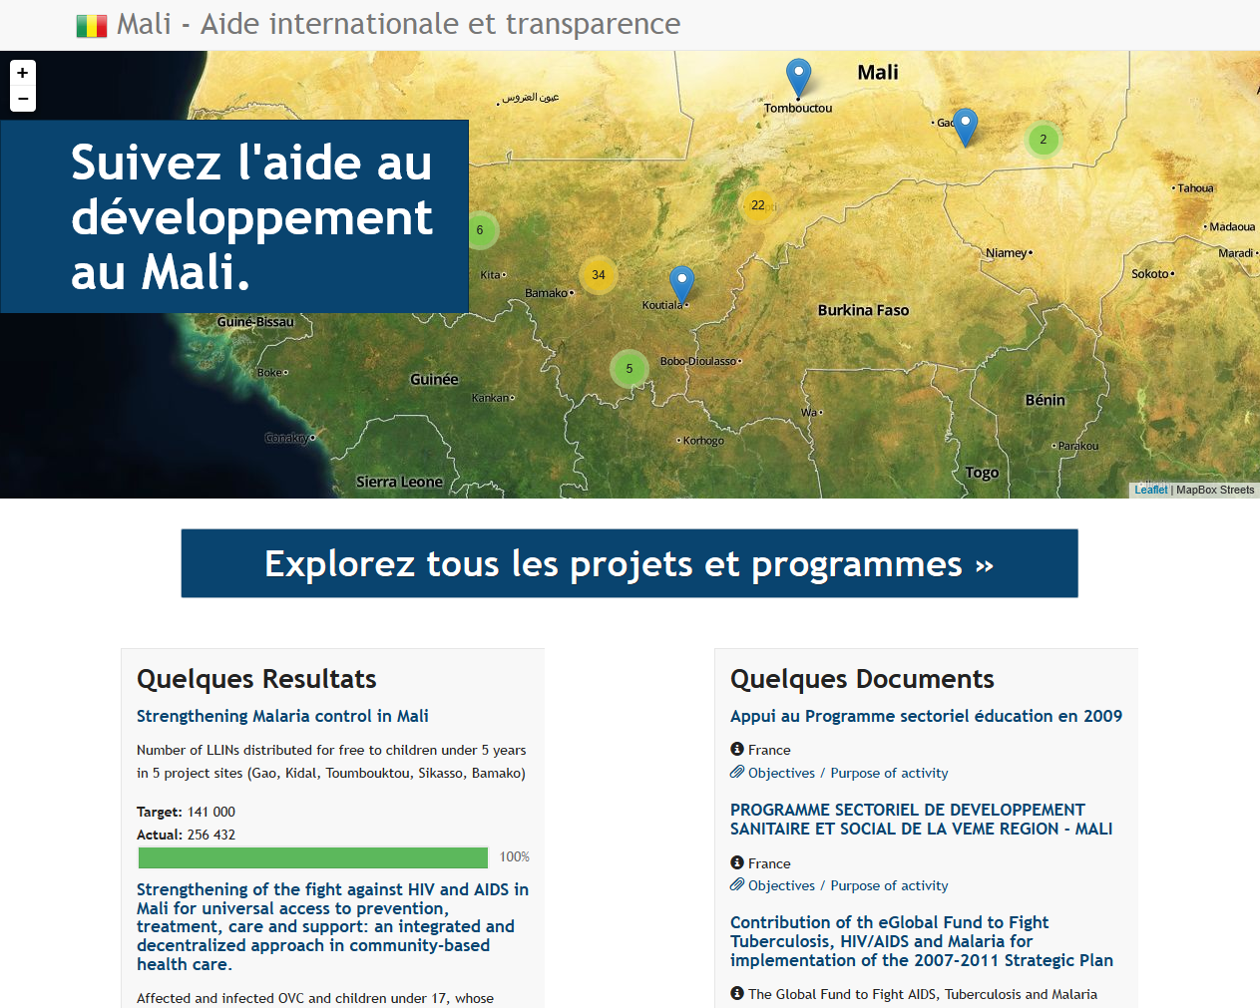
SHOW PROJECTS ON A MAP
Source: http://mali.publishwhatyoufund.org

Slide 4
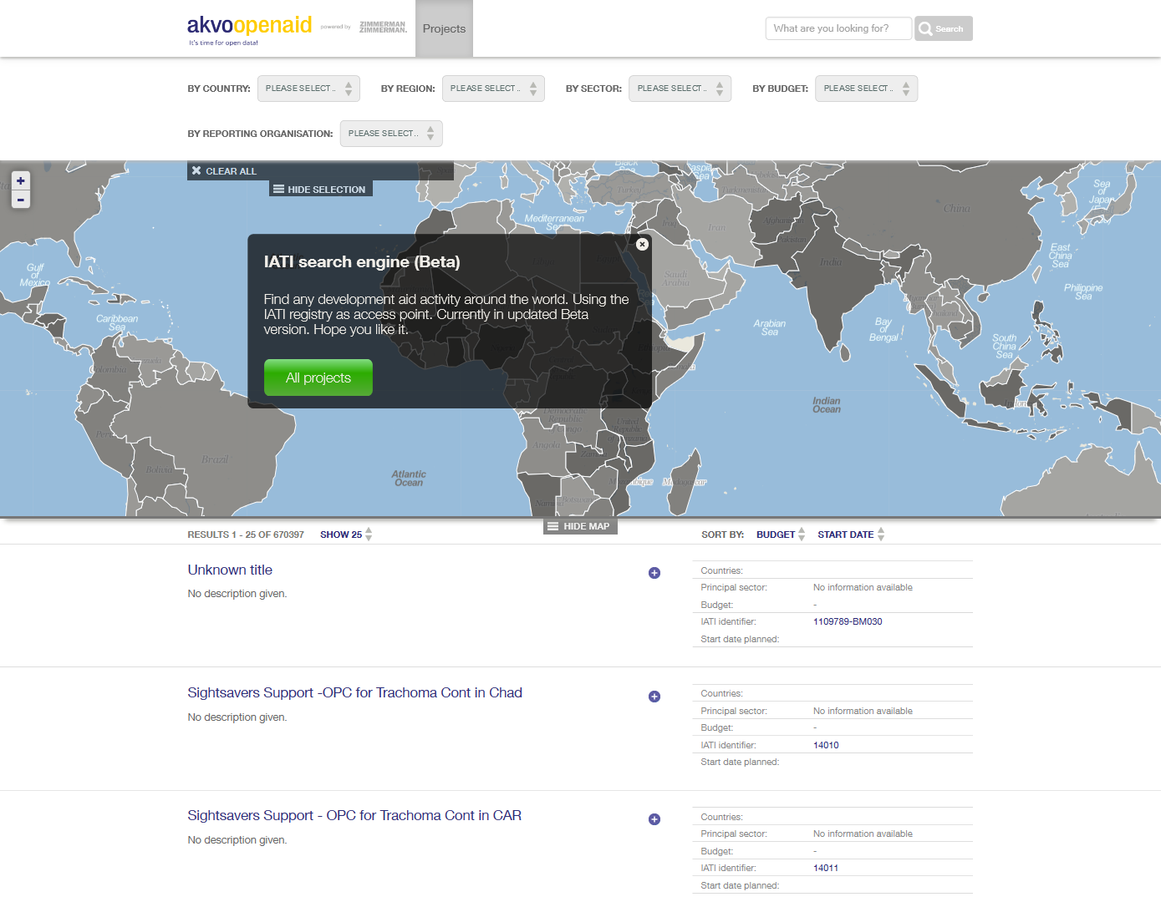
Source: http://openaidsearch.org

Slide 5
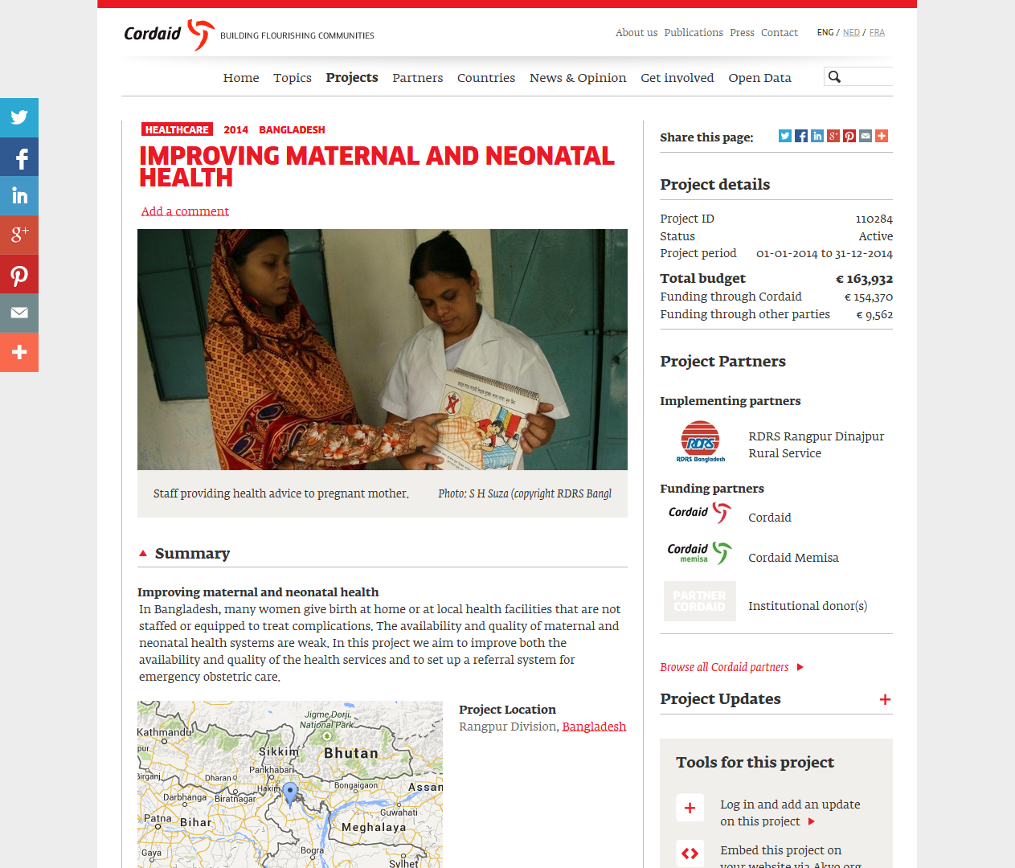
SHOW PROJECTS ON YOUR WEBSITE
Source: http://www.cordaid.org/en/projects

Slide 6
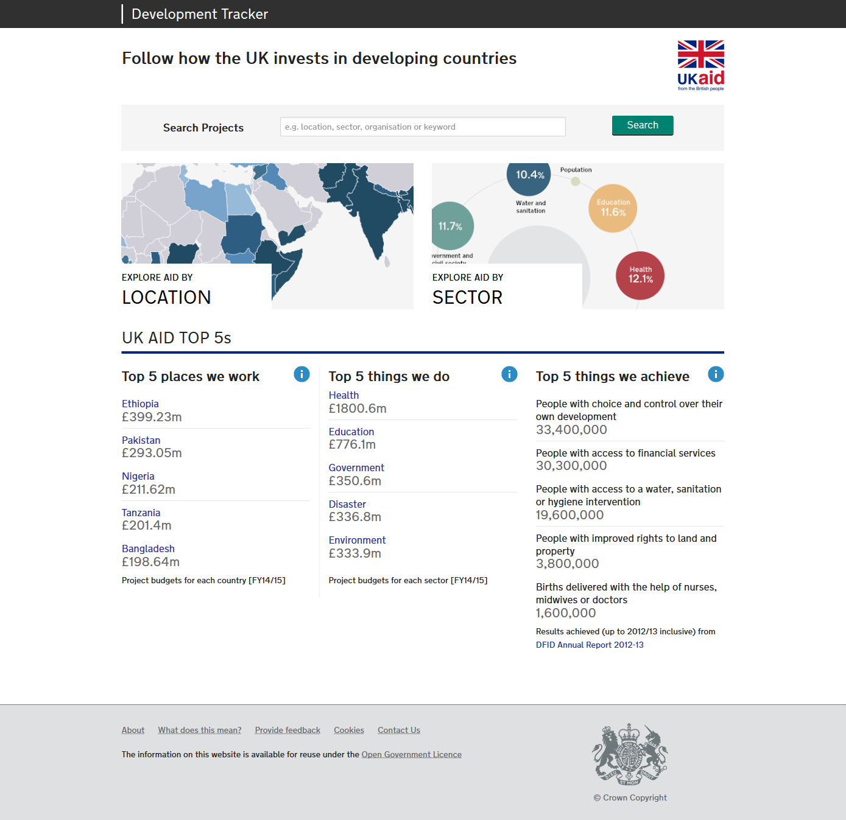
GAIN INSIGHT IN A COUNTRY’S AID PORTFOLIO
Source: http://devtracker.dfid.gov.uk

Slide 7
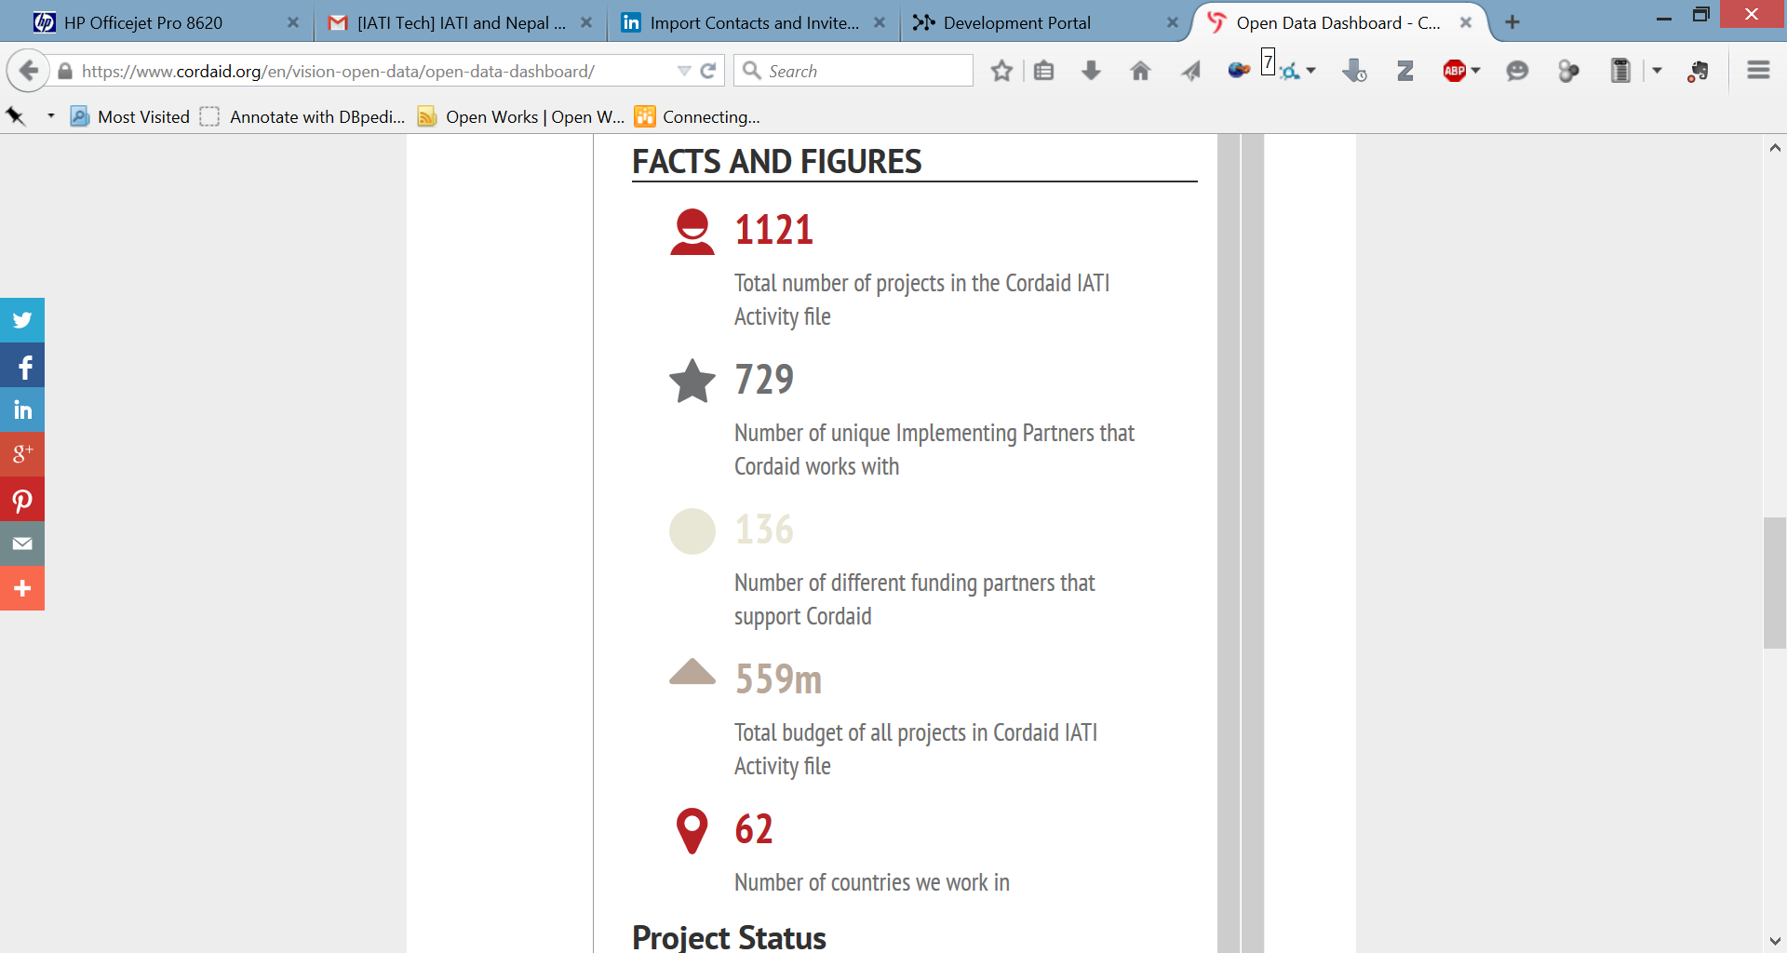
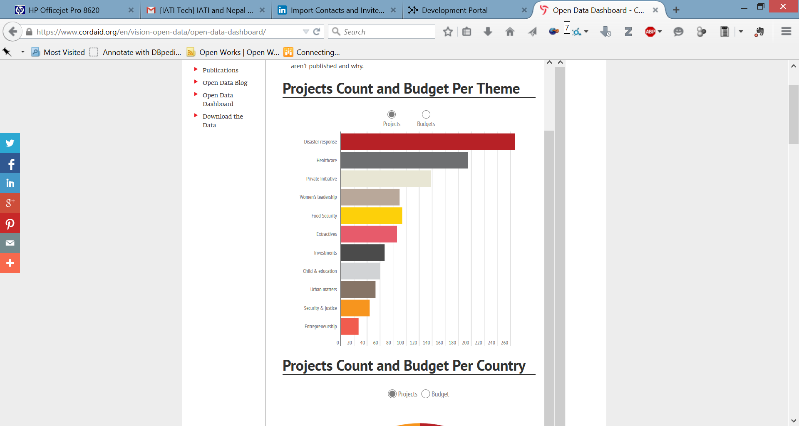
STATS & FIGURES
A complete IATI file – covering all your organisations activities – can easily provide some basic statistics.
These images are taken from Cordaids Open Data Dashboard.

Slide 8
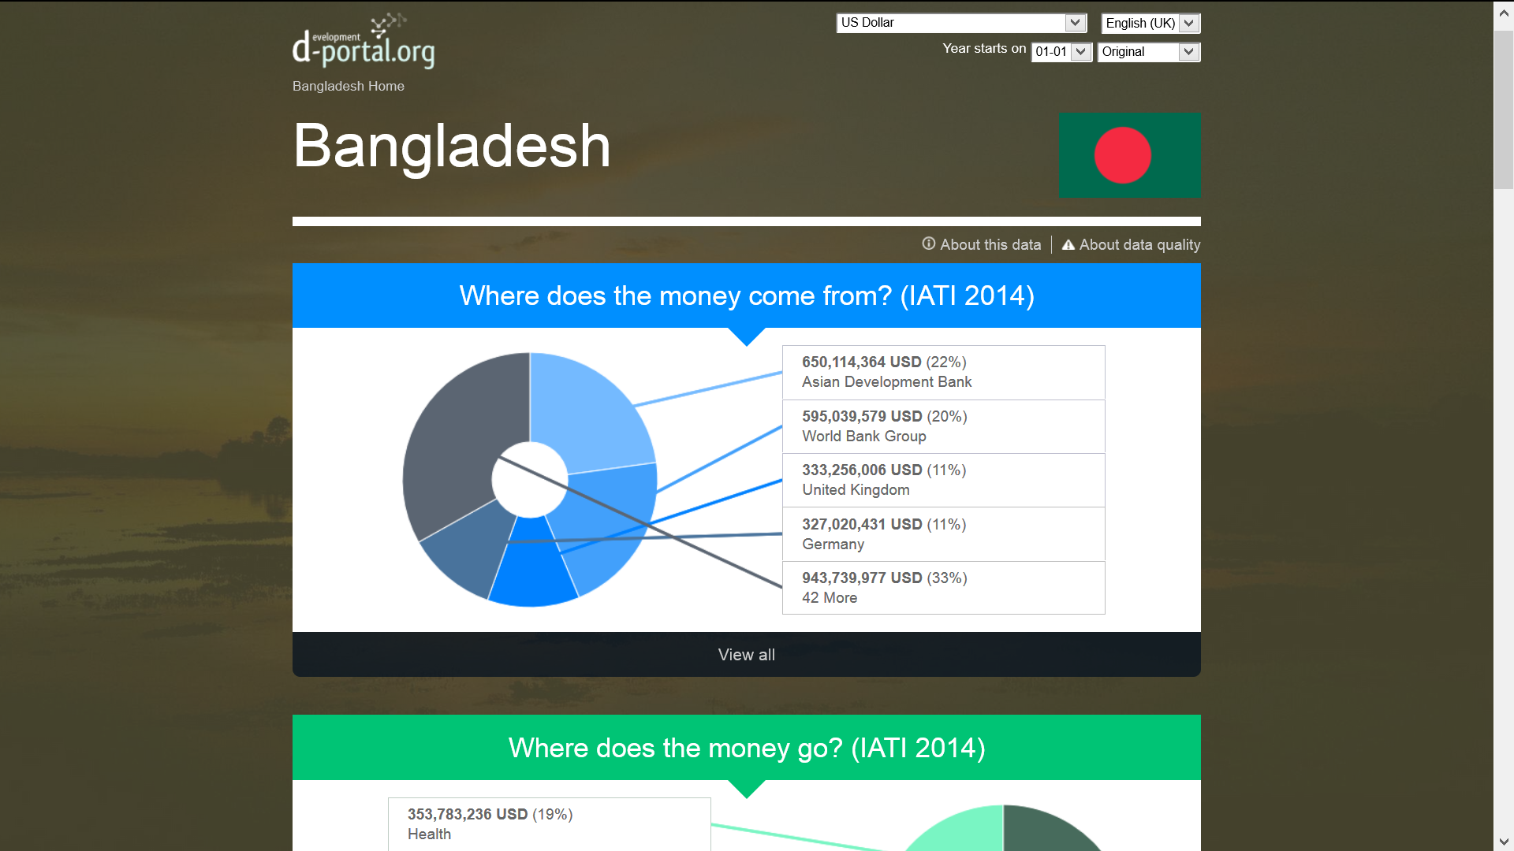
MORE FIGURES

Slide 9
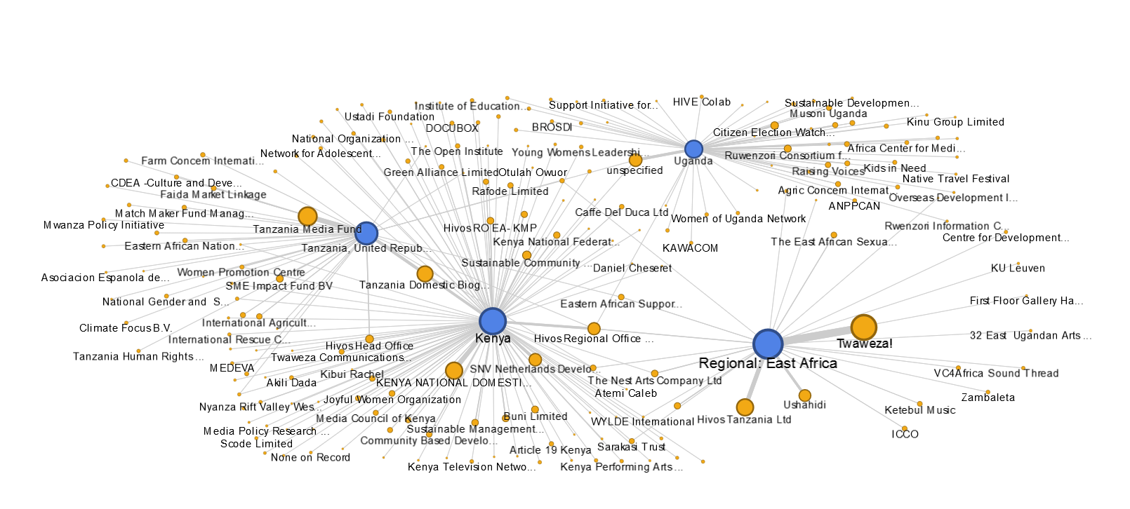
GAIN INSIGHT IN NETWORKS
Which are the partners Hivos works with in East Africa?
An analysis based on their IATI file
1. SHOW PROJECTS ON A MAP
Source: http://mali.publishwhatyoufund.org

Slide 10
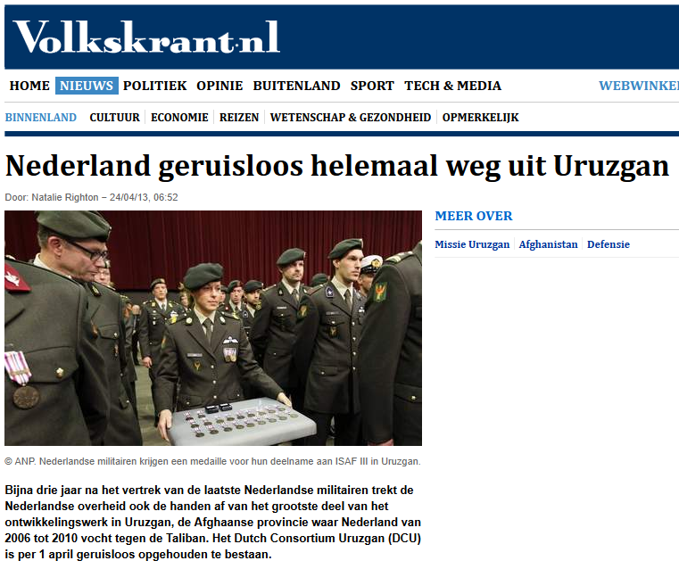
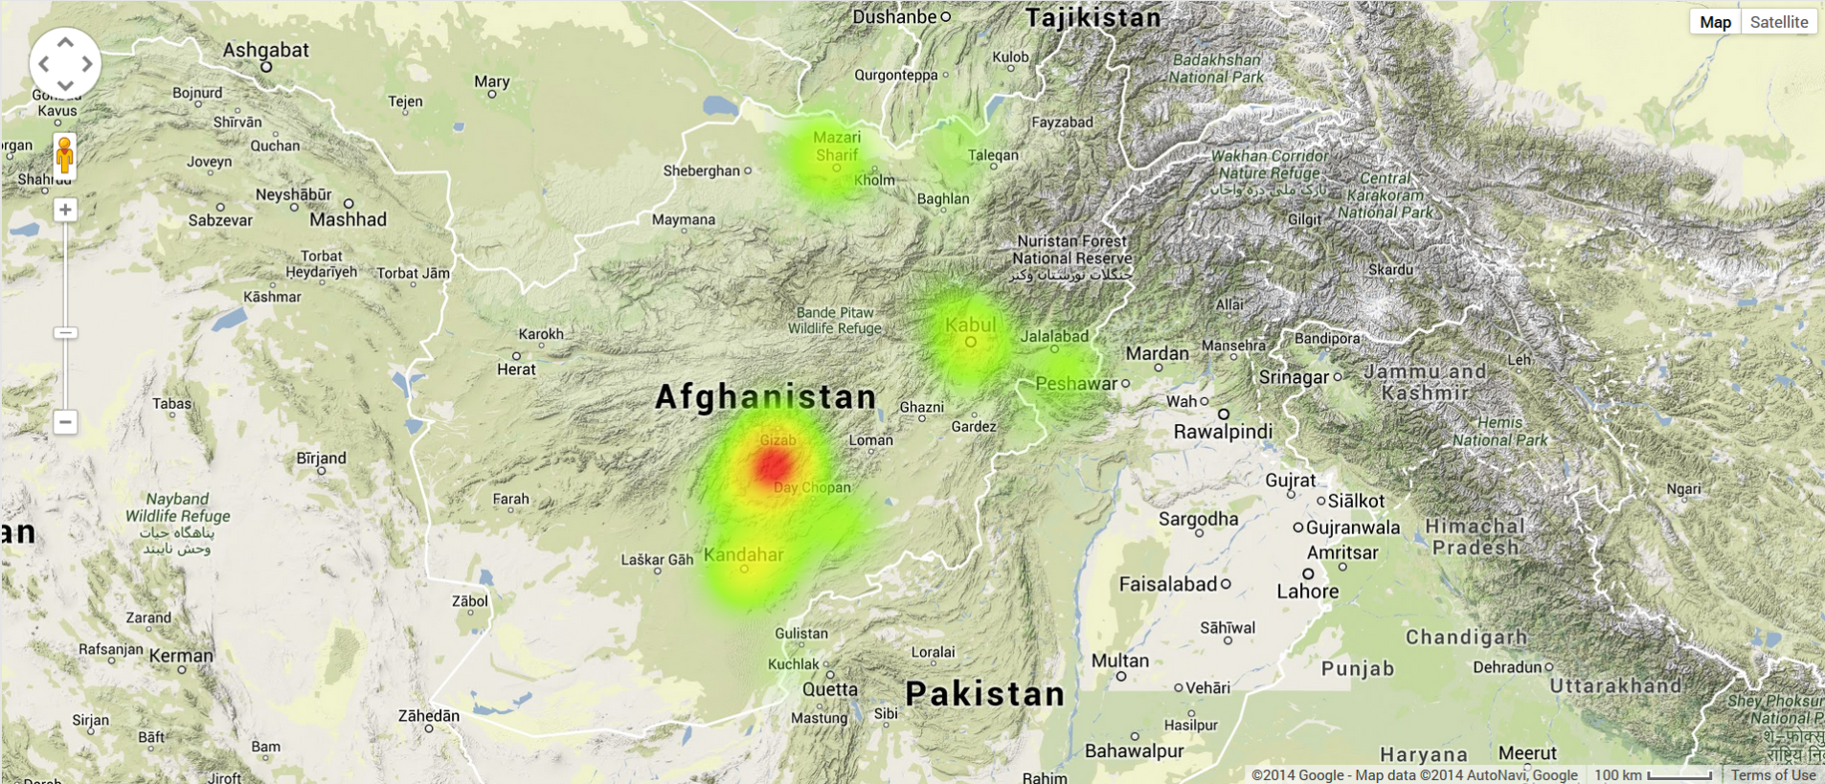
BETTER JOURNALISM
The newspaper article says ‘The Netherlands’ have left Uruzgan, while the data show a concentration of development projects in Uruzgan (with increasing budget)
- Based on Cordaid IATI activity set.

Slide 11
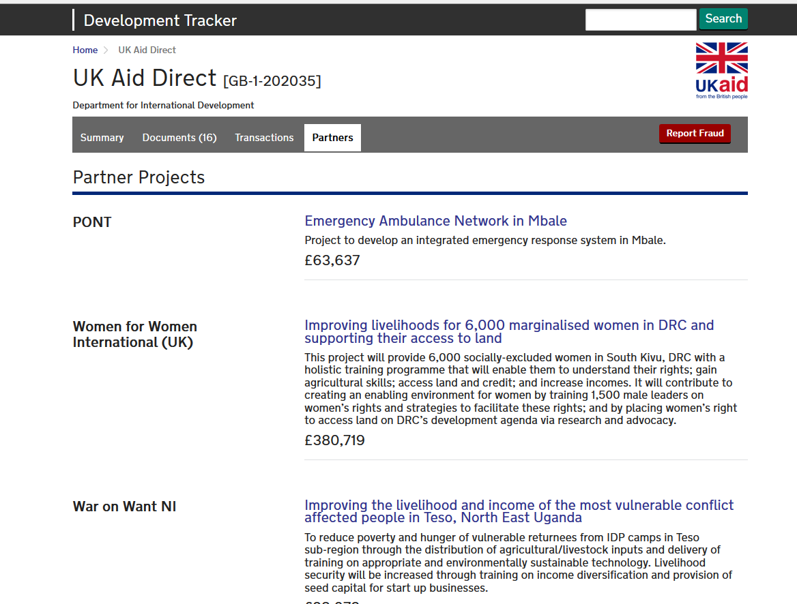
GAIN INSIGHT IN THE DEVELOPMENT CHAIN

Slide 12
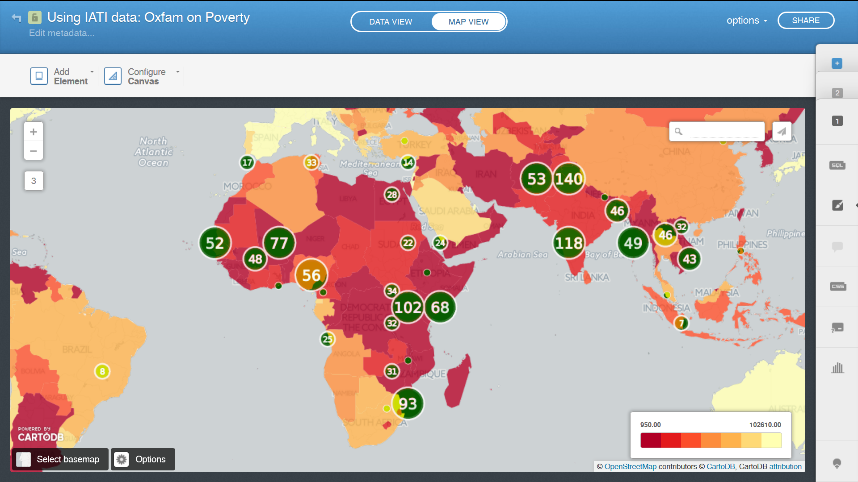
LINK WITH OTHER DATA
Oxfam Novib's mission is to overcome poverty. But does Oxfam Novib really work in the world's poorest countries? A quick analysis based on its IATI open data & the World Development Index.

Slide 13
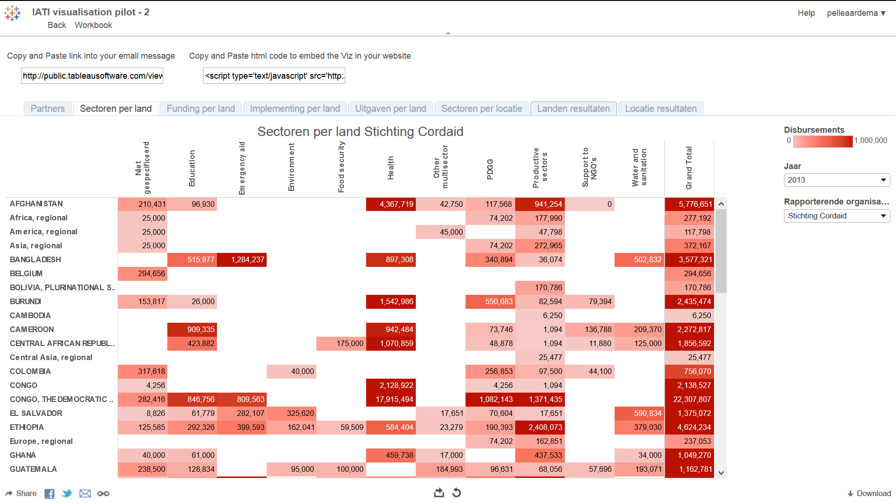
GAIN INSIGHT IN AN NGO’s WORK & RESULTS
Source: IATI visualisation pilot – Dutch MFA

Slide 14
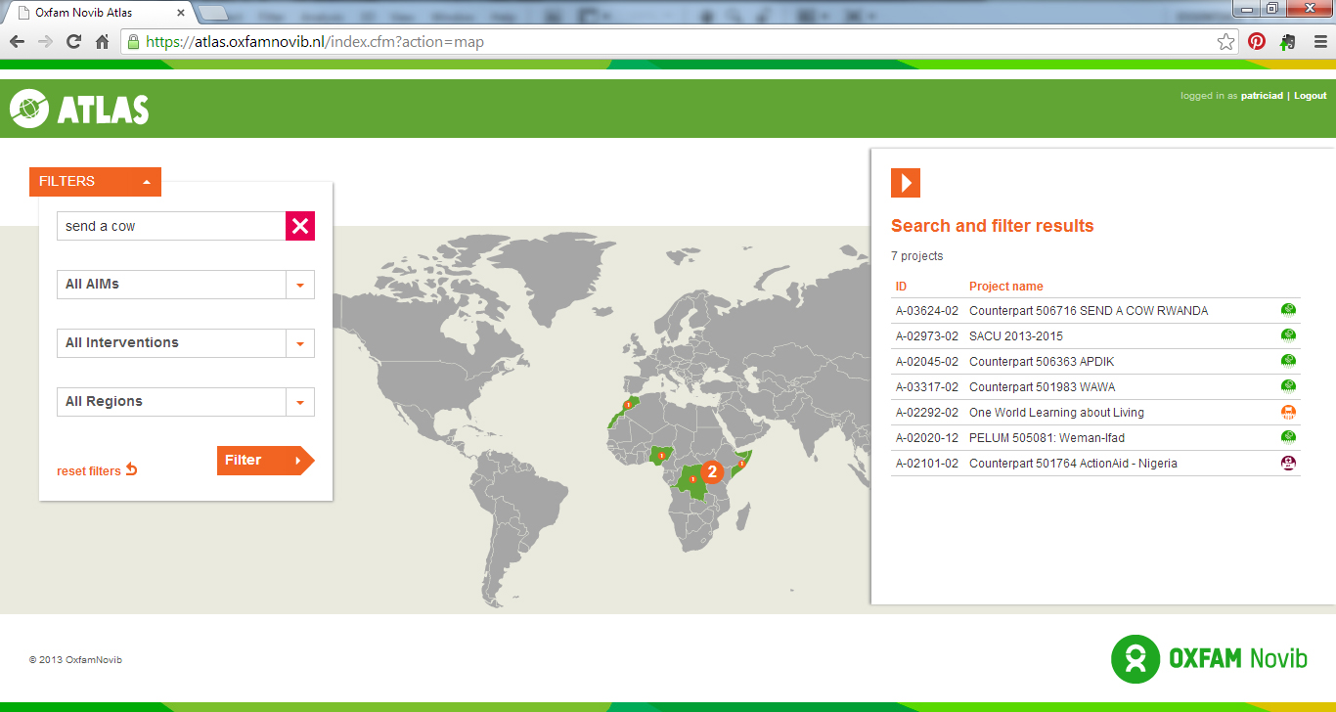
INTERNAL INTELLIGENCE
Oxfam Novib (internal) project browser

Slide 15
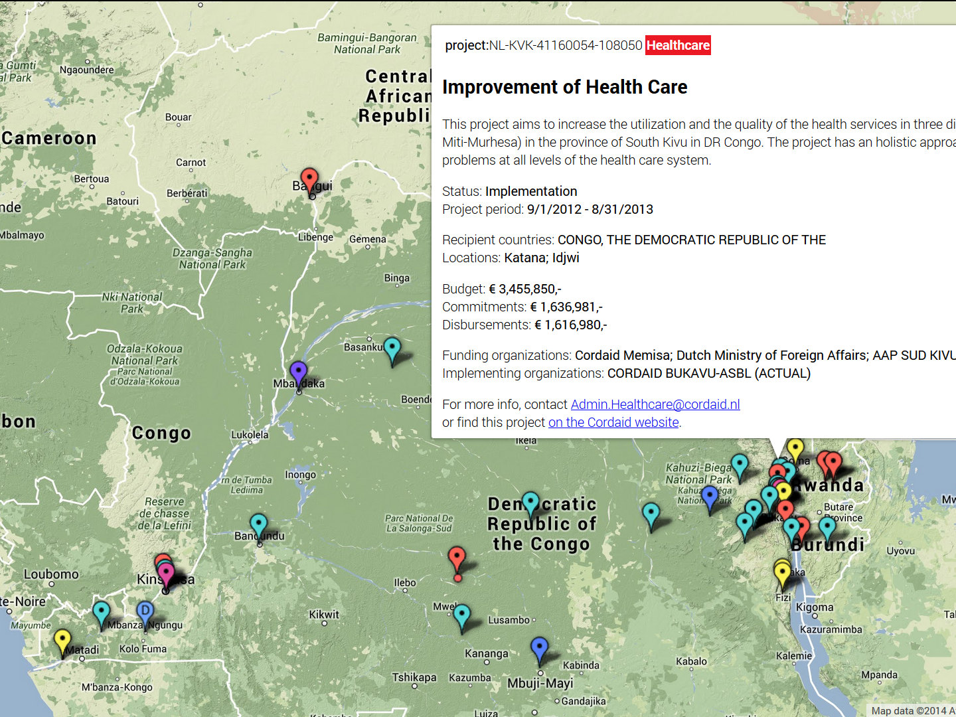
Which Cordaid business unit works where in DRC?
This analysis was made during the Cordaid Data Journey in January 2014.

Slide 16
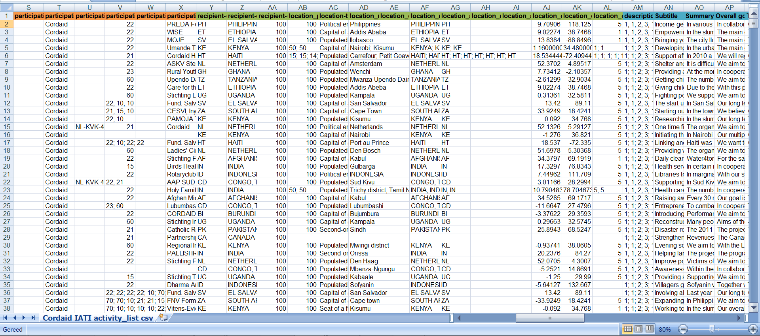
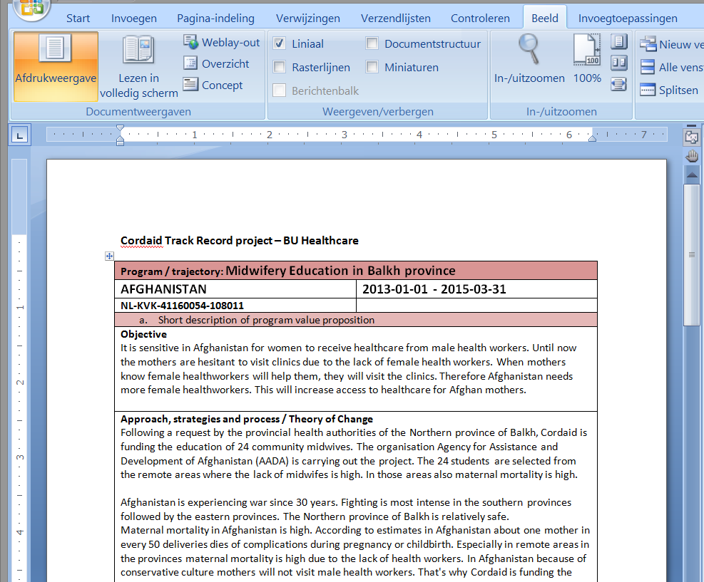
SHOW YOUR TRACK RECORD
With the IATI activity file loaded in Excel, and a simple mail merge, you can easily produce a track record document filtered on country, theme, period, budget, …

Slide 17
7 WAYS TO USE IATI DATA
7 WAYS TO USE IATI DATA | LINKS
1. Show projects on a map | http://mali.publishwhatyoufund.org http://openaidsearch.org
2. Show projects on your website | http://cordaid.org/en/projects
3. Insight in a countries aid portfolio | http://devtracker.dfid.gov.uk
4. Better Journalism | http://www.volkskrant.nl/vk/nl/2686/Binnenland/article/detail/3430955/2013/04/24/Nederland-geruisloos-helemaal-weg-uit-Uruzgan.dhtml http://bit.ly/cordaid-data-journey
5. Get insight in an NGOs work & results | http://bit.ly/iati-dash-pilot
6. Internal intelligence | Oxfam project browser: available online soon http://bit.ly/cordaid-data-journey-1
7. Show your track record | <not available online>

Slide 18



Pelle Aardema
pelle@openforchange.info
@pelleaardema
More about Open for Change :
http://openforchange.info
info@openforchange.info @open_for_change
This work is licensed under a Creative Commons Attribution-ShareAlike 4.0 International License.
Image © www.planetxam.nl

